Slide 1
Into the Tidyverse Session 2a
Course written by Tim Hargreaves

Slide 2
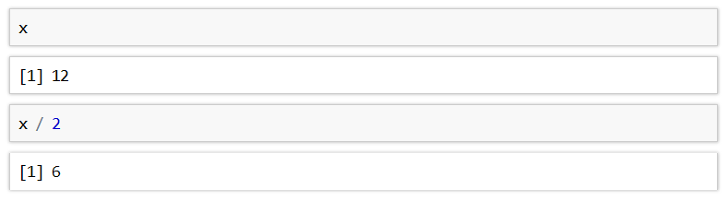
Objects
R is capable of storing any value in an object (also called variables)
Objects are simply a way of labelling a piece of data for later use
In R, objects are assigned using the <- operator
Once an object has been assigned a value, it can be referenced by using its name

Slide 3
Objects
All R statements where you create objects have the form
An object will retain its value until one of the following occur:
You close RStudio
You delete the object manually
You overwrite its value with another
You can see a list of all objects in the 'Environment' pane in RStudio
If you are getting tired of tying <- you can use the keyboard shortcut alt-minus in RStudio to insert

Slide 4
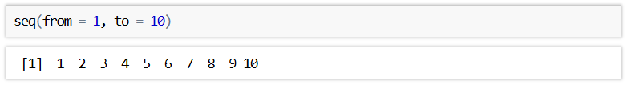
Functions
R has a large collection of built-in functions that are called like this:
An example of such a function is seq() which makes a regular sequence of numbers

Slide 5
Exercises to try
Object_name <- function(arguments)
Create an object called integers and assign a sequence to it using the seq()function. Your sequence should start at 0 and end at 100.
Type into your console : integers ^ 2
How do you think this operator will work on a list of numbers ?
Create an object called x containing 1000 numbers spaced uniformly between -6 and 6.
You can do this by adding the length.out parameter :
seq(from=?,to=?,length.out= ?) and setting it to 1000

Slide 6
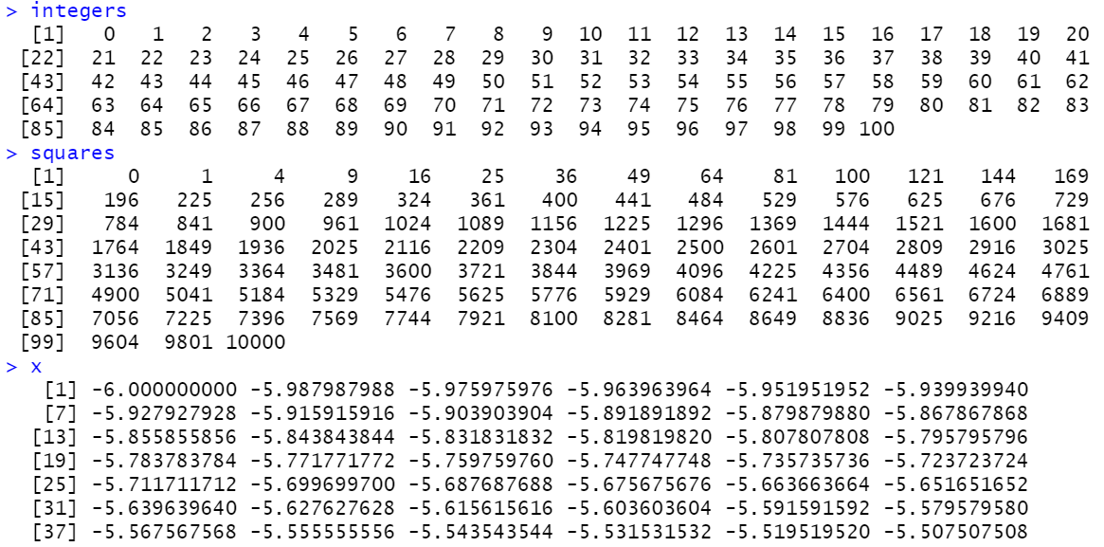
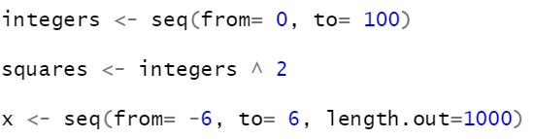
Answers

Slide 7
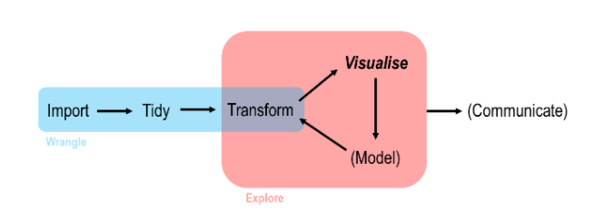
Data Analysis work flow in R

Slide 8
Readr

Slide 9

What is readr
readr is another of the many packages included in the tidyverse
It allows you to import data from a wide variety of storage formats
It is designed to balance import speed, ease-of-use, and consistency

Slide 10
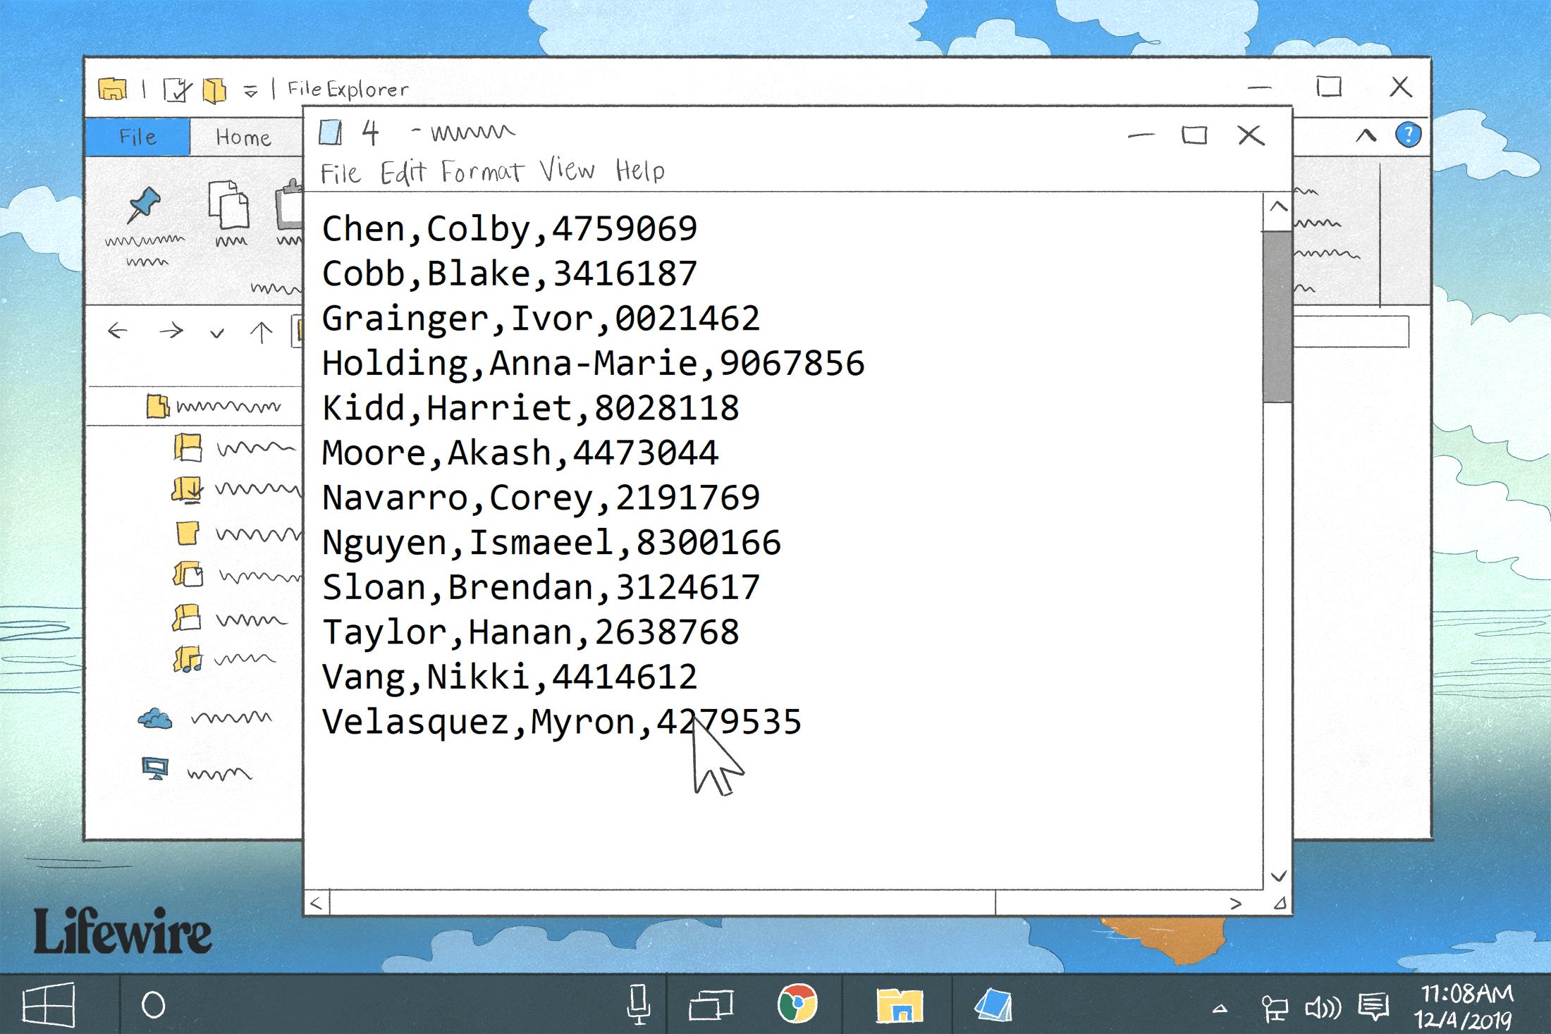
CSV files
Common-separated value (CSV) files are almost certainly the most common storage format for flat data
Each observation occupies its own line and fields are separated by commas (hence the name)
CSVs can contain a header row with column names, although this is not always the case

Slide 11
Paths and Directories

Slide 12
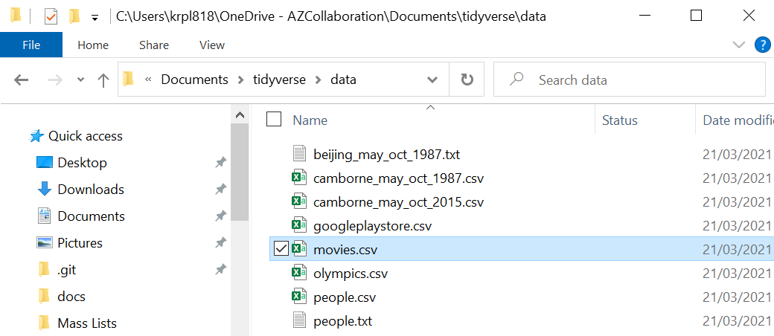
What are paths and directories
Path
Folder /directory
Data files have a name and are located in a folder
A folders is the same a directory
How we get to this folder in our file explorer is our pathway

Slide 13
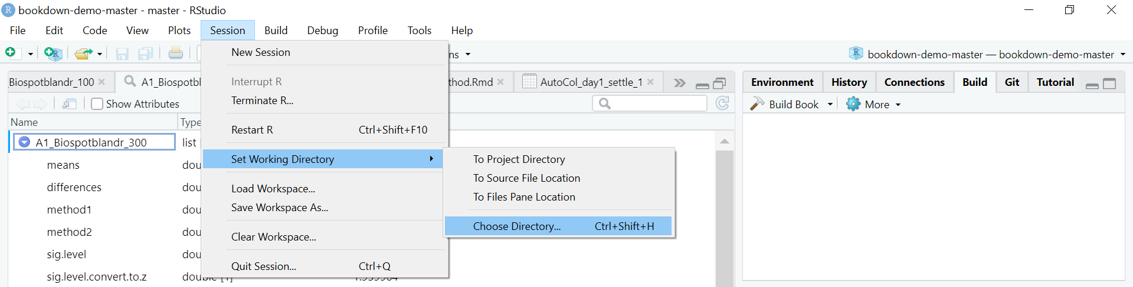
Setting your directory in R
To load datasets into R its always best practice to set our directory to the folder which our datasets are stored in
To do this we can go into session > set working directory > choose Directory > then select the folder with the Tidyverse datasets in

Slide 14
Reading in external data

Slide 15
read_cvs
You can import a CSV file using the read_csv() function
The first argument is the most important it's the path to the file to read or if you’re working directory is set to the folder where the data is stored then just the file name
The path of the file should be relative to your current working directory
This can be changed using Session > Set Working Directory > Choose Directory or by using Ctrl+Shift+H

Slide 16
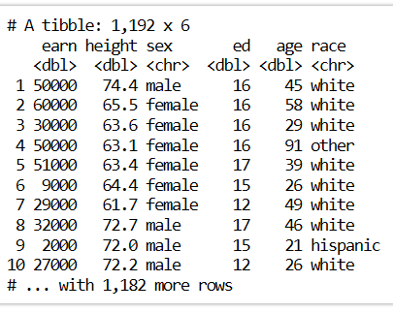
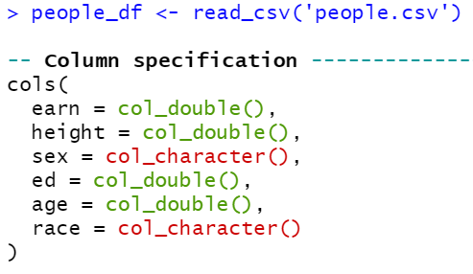
read_cvs
When using the read_csv() function, you are outputted a message containing the column names and types

Slide 17
Exercise to try
Object_name <- read_csv('filename.csv')
Create an object called movies_df and read in the movies.csv file to this object you should now be able to see this dataframe in the environments tab
Select the first 5 rows of this movies_df object
(Make sure to have changed your directory to the folder where the datasets are stored or alternatively write the whole path the the file in the command )

Slide 18
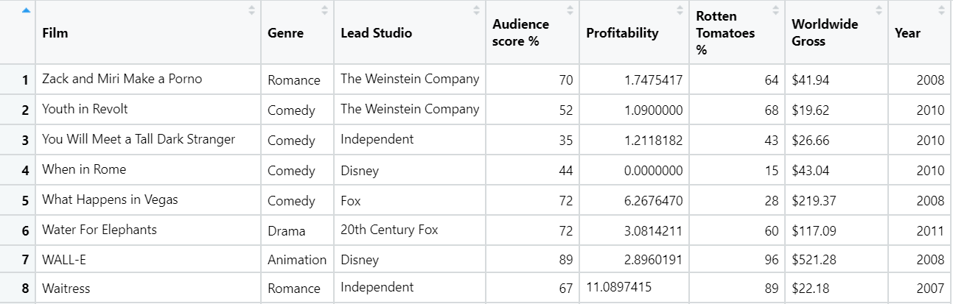
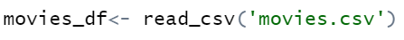
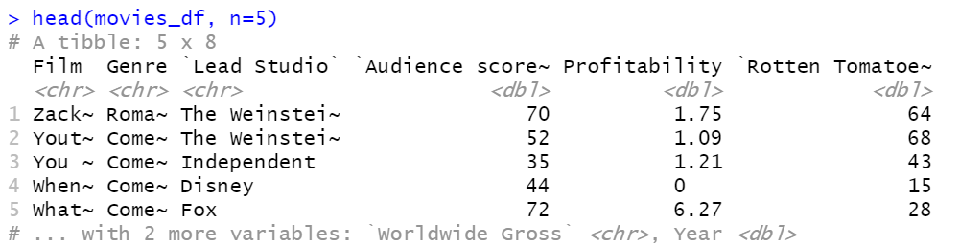
Answer

Slide 19
Tibbles

Slide 20
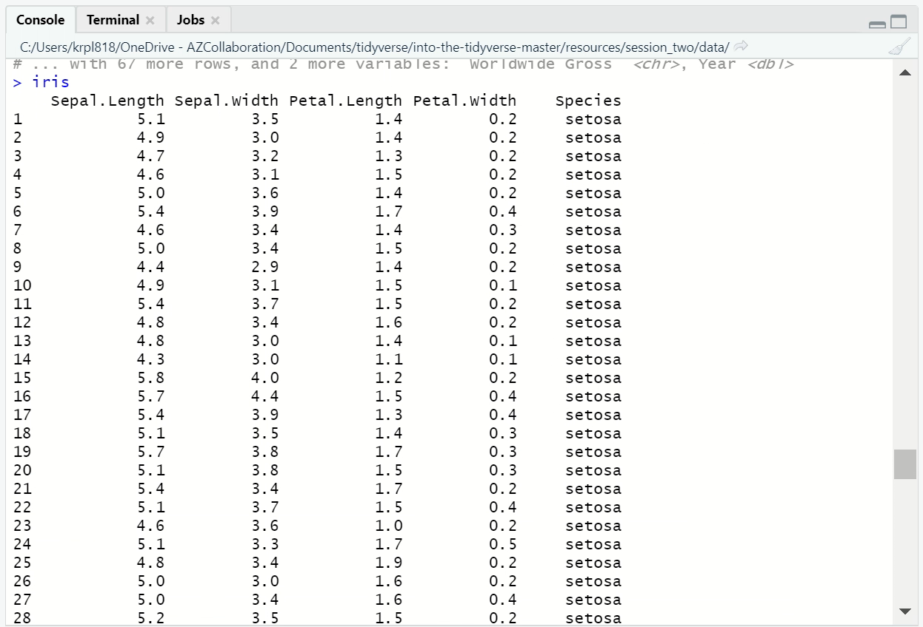
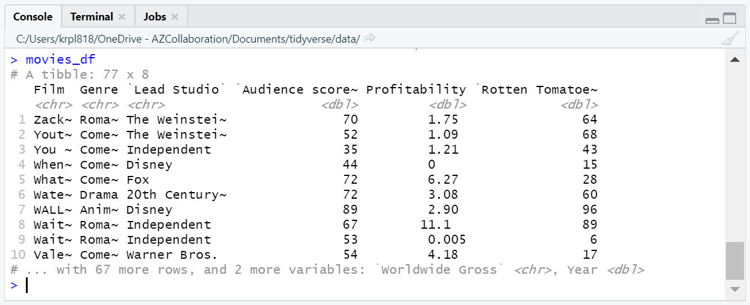
Tibbles

Slide 21
Tibbles
Tibbles are just standard R data frames, but they tweak some old behaviours to make life a little easier
Tibbles limit how many rows and columns to avoid flooding the console
They also give you useful tips such a column types and the dimension of the data frame
A standard R data frame can be converted to a tibble using the as_tibble() function

Slide 22
Data input inside the script

Slide 23
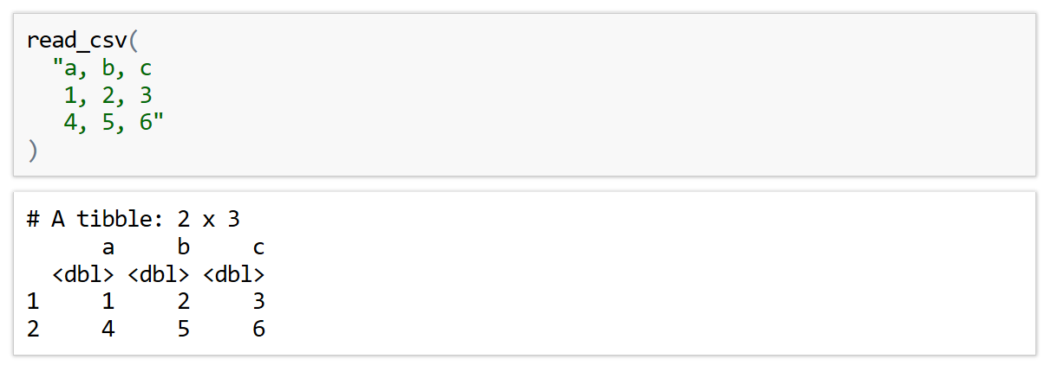
In-line CSV
For the purposes of testing code, the read_csv() function can process an in-line CSV
This is also important for creating reproducible examples

Slide 24
Readr parameters

Slide 25
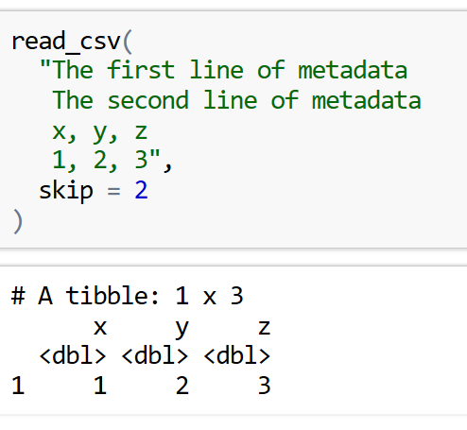
Skip Parameter
Sometimes we have metadata / comments at the top of our files that we don’t want to include
To prevent reading in these lines we can use the skip or comment arguments
The skip argument can be used to skip a specified number of rows in the CSV file before starting to read data
This is useful when your CSV contains metadata at the top of the file

Slide 26
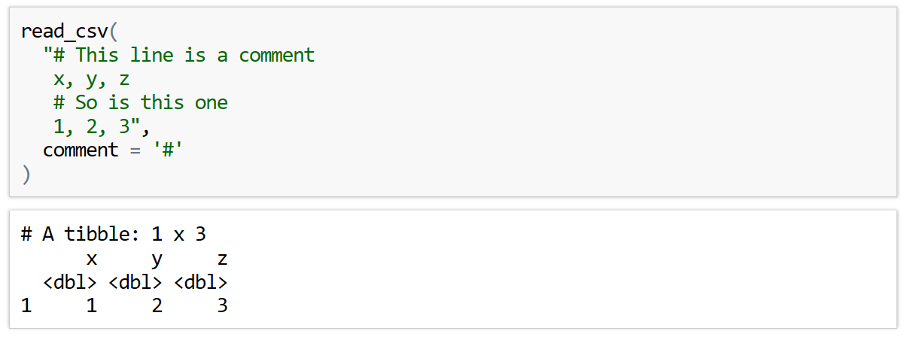
Comment Parameter
The comment parameter can be used to drop all lines starting with a specified character

Slide 27
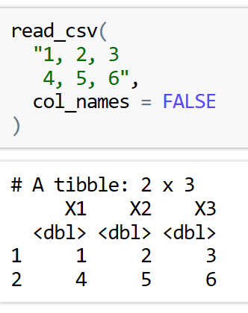
Manual Column names
It may be the case that the CSV file you are importing does not have column names
In this case you can use the col_names parameter to control what to do
Setting col_names = FALSE will tell read_csv() that the first row of the CSV file is data and that the column should be labelled using generic names 'X1', 'X2', etc.

Slide 28
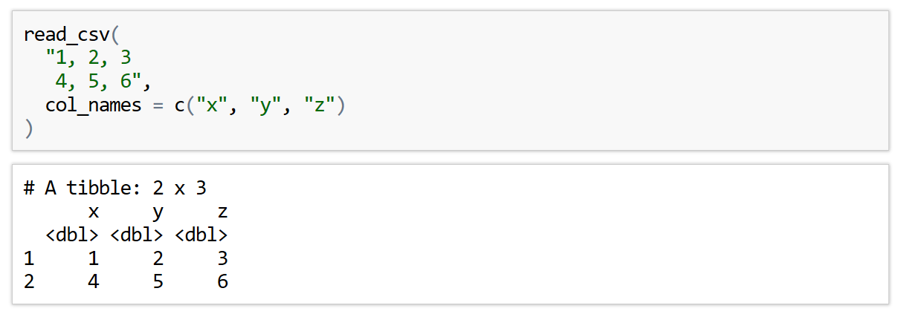
Manual Column names
Alternatively, if you know what the column names should be, you can specify then using a character vector

Slide 29
Exercise to try
Read the following in-line CSV into R. Things to note:
The columns of this dataset are City, Area, Population they’re not already present
Make sure you don’t try to read the comment line
Template:
read_csv(
"data1a , data2a ,data3a
data1b , data2b , data3b",
comment = '?',
col_names=c('name1','name2','name3'))
"Shanghai, 6341, 27058000
Tokyo, 627, 13515271
Seoul, 605, 9806000
>> Mumbai was previously called Bombai
Mumbai, 438, 12442373 "

Slide 30
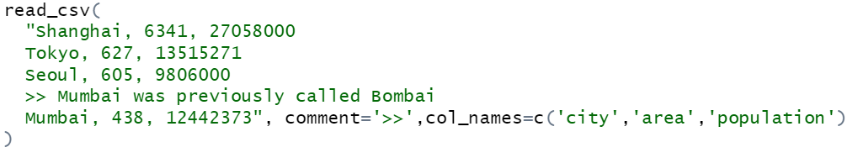
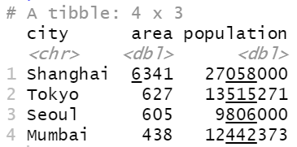
Answer

Slide 31
Calculations

Slide 32
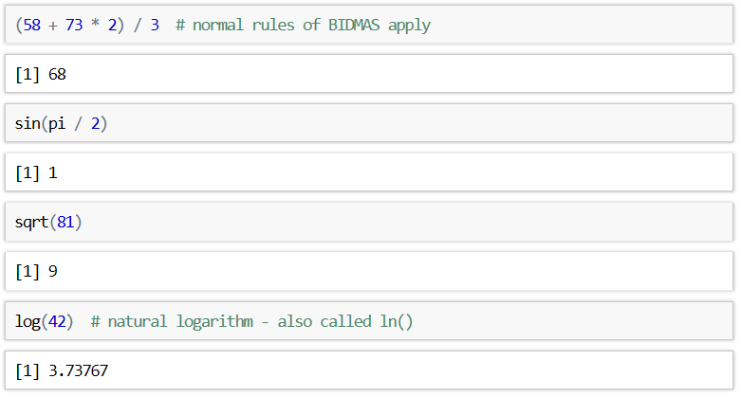
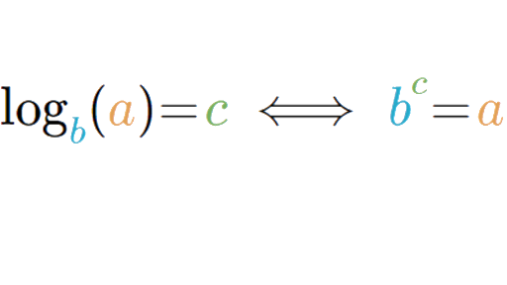
R as a calculator
We can also use things like trigonometry, square roots and logs in r
Normal format
R format
log(a,b)

Slide 33
Bonus Questions

Slide 34
Web Scraping
Web scraping is a technique for converting the data present in unstructured format (HTML tags) over the web to the structured format which can easily be accessed and used
We can use Web browsers to retrieve these datasets
We first need to install rvest and robotstxt :
install.packages('rvest’)
install.packages(‘robotstxt’)

Slide 35
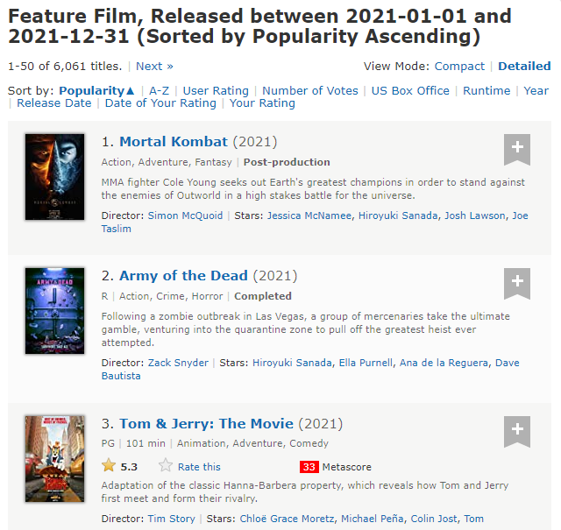












Looking at featured films dataset
We can scrape the following data categories:
Rank
Title
Description
Runtime
Genre
Rating
Director
Actor

Slide 36
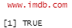
Web Scraping
We’re going to looking at film data from this link:
https://www.imdb.com/search/title/?year=2021&title_type=feature&
Lets check if we can scrape data from It firstly
Opening it in R Studio:

Slide 37
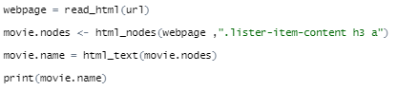
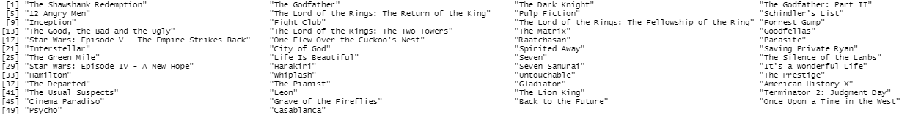
Accessing the categories
We have our variable webpage containing the html dataset but we want to access the data to see it:
Html object
Path to node

Slide 38
Access other variables using these paths
Have a go by copy and pasting these paths to access different categories of data
Year of release – ".lister-item-content h3 .lister-item-year"
Runtime – ".lister-item-content p .runtime"
Genre – ".lister-item-content p .genre"
Certificate – ".lister-item-content p .certificate"
More explanations and documentation can be found here for web scraping :
https://blog.rsquaredacademy.com/web-scraping/
If you want a have a go at creating some plots using this data or creating Dataframes from it have a read of this article:
https://towardsdatascience.com/introduction-to-data-frames-in-r-b9a6302d9a56

Slide 39
Next Time ….
Vectors
Plotting our new datasets
Line graphs
Global aesthetics
See you then !

Slide 40
Into the Tidyverse Session 2b
Course written by Tim Hargreaves

Slide 41
Vectors

Slide 42
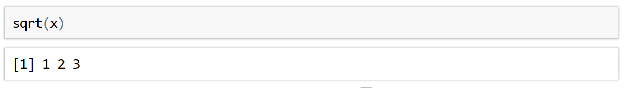
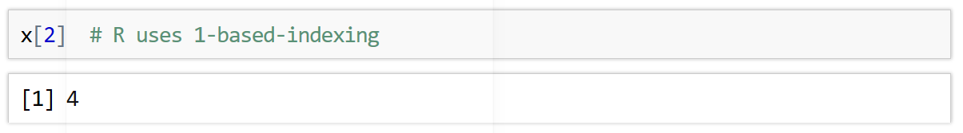
Vectors
In R, a vector is a collection of elements of the same type
There are integer vectors, character vectors, double vectors, and many more
Vectors are created using the c() function. This stands for combine:
Most mathematical functions in R act element-wise on vectors
A particular value of a vector can be accessed using [ ]

Slide 43
Exercise to try
Create a character vector of 5 city names and assign it to an object called cities
Select the 5th item in the character vector

Slide 44
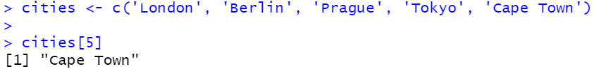
Answers

Slide 45
Dealing with missing values

Slide 46
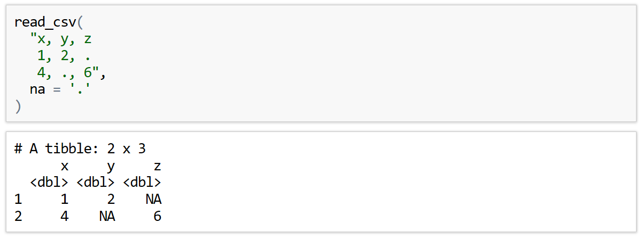
Missing Values
In the real world, it is rare to ever have a complete data set
Missing values can be encoded using a range of symbols - ., ?, N/A, -, etc.
You can tell readr() which symbol is used in a given CSV file using the na parameter

Slide 47
Exercise to try
Read the following in-line CSV into R.
Unknown is used here to represent missing values
There’s a few lines you will want to skip
"
Employee Database Version 3
name, age, job
John, 34, Analyst
Ann, 44, Consultant
Barry, 24, Unknown
Freya, Unknown, Developer"
Template:
read_csv(
"data1a , data2a ,data3a
data1b , data2b , data3b",
skip = ?,na= ?)

Slide 48
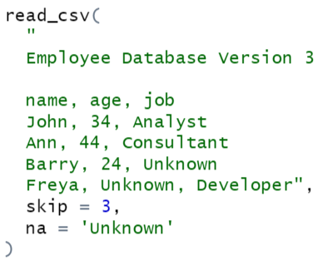
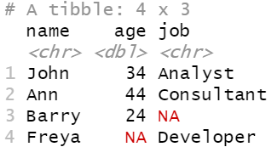
Answer

Slide 49
More file types

Slide 50
Other file types
More Delimited Files
read_csv2() - semicolon-separated files
read_tsv() - read tab-separated files
read_delim() - reads files with any delimiter
read_delim('path/to/file.txt', '|’)
These all accept the same additional arguments as read_csv()

Slide 51
Exercises to try
Remember to set your working directory first with Session > Set Working Directory > choose directory
Read the people.csv file from your data folder containing the Tidyverse datasets and assign it to an object called people_df
How does level of education affect earnings ? Make a scatter plot to find out.
You should set position = 'jitter’ and avoid over-plotting by setting transparency( alpha ) to 0.5.
BONUS : Facet the above plot by sex, colouring the points by sex too facet_wrap(~sex)
ggplot(data=?)+geom_point(mapping=aes(x=?,y=?),position=?,alpha=?)

Slide 52
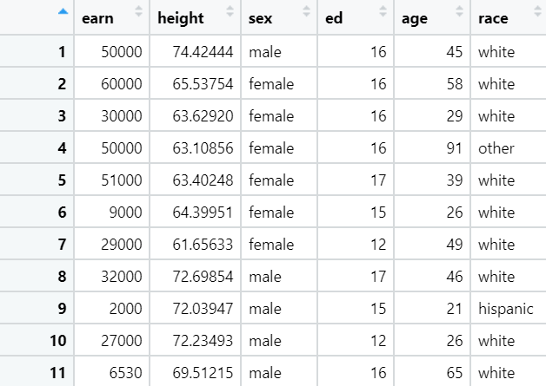
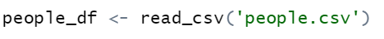
Answers 1)

Slide 53
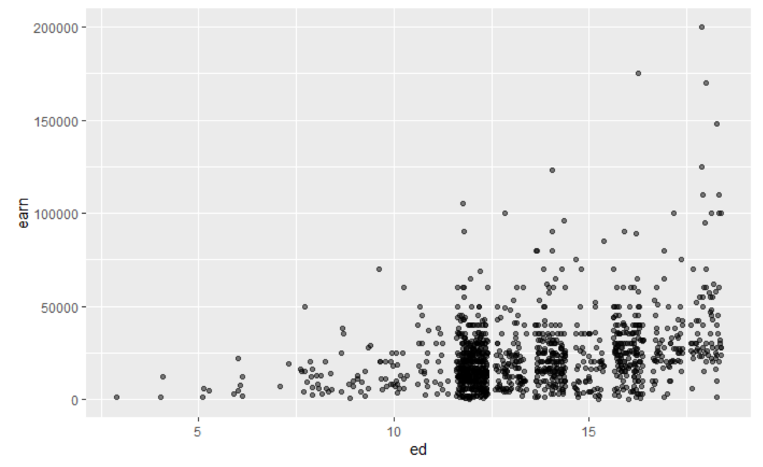
Answers 2)

Slide 54
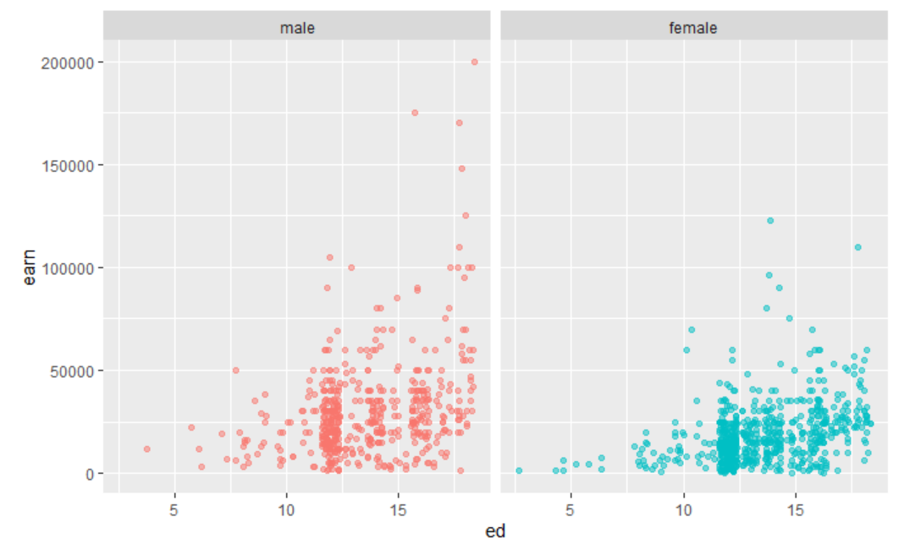
Answers 3)

Slide 55
More Data Visualisations
Notes:
last thing i'm going to look at is a bit more about data visualization
specifically looking at creating line plots

Slide 56
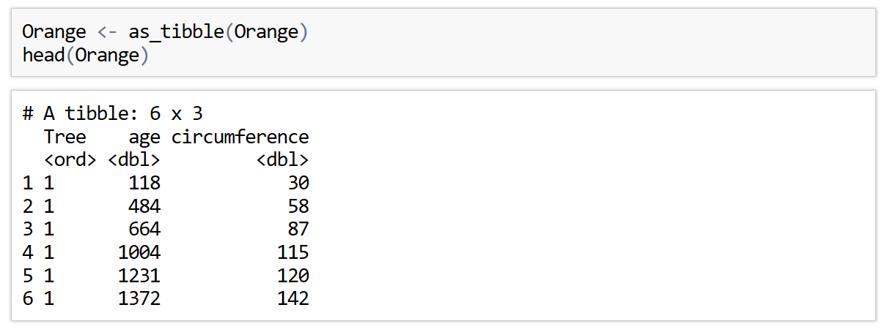
Line Plot
So far, we have only produced scatter plots and that's a bit boring
By changing which geometry we use, we generate a line plot
A dataset suited to this type of graph is the Orange dataset

Slide 57
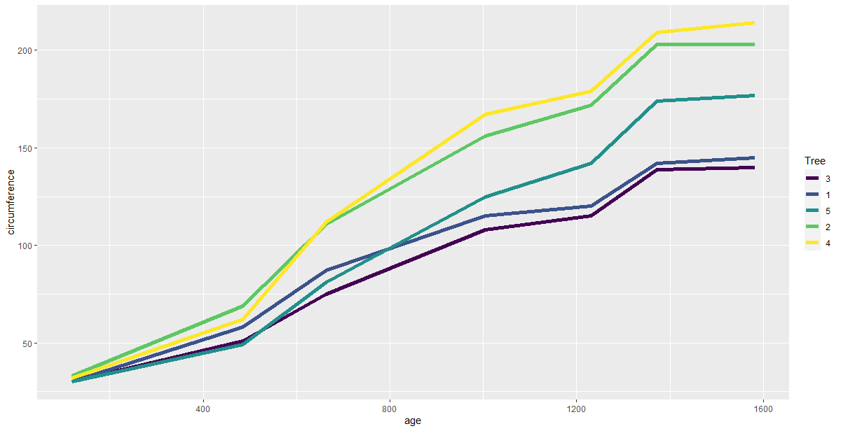
Line Plot
A line plot is produced by using the geom_line() geometry

Slide 58
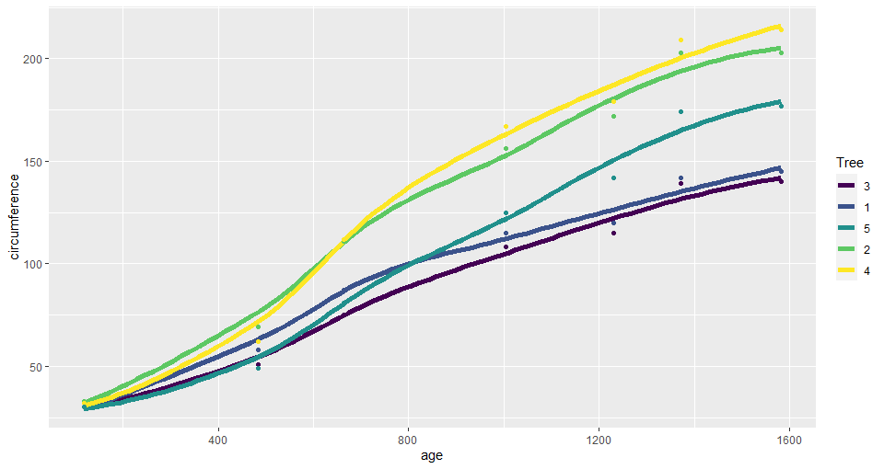
Smooth Line Plot
A similar geometry is geom_smooth(). This adds a smooth fitted line to a plot
This can be combined with geom_point()to create the following graph →

Slide 59
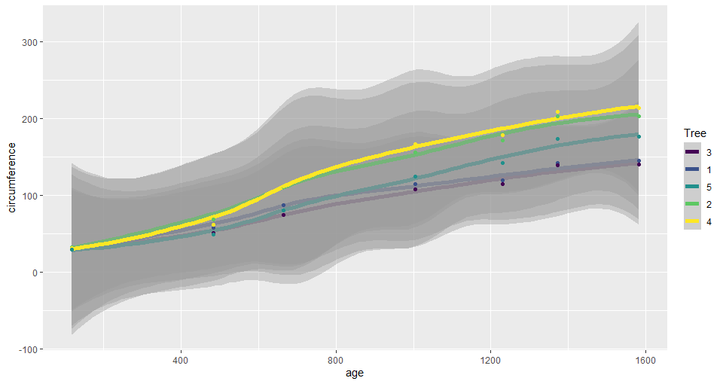
Smooth Line Plot
Use can use the se argument to control whether confidence intervals are shown
se = TRUE
se = FALSE

Slide 60
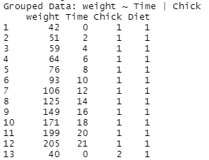
ChickWeight

Slide 61
Exercises to try
ggplot(data=?)+geom_line(mapping=aes(x=?,y=?,colour=?,group=?))
Using the built in dataset ChickWeight make a line plot of the weight against Time. Group by Chick and colour by Diet by adding group = Chick inside the aes() function
Instead of using geom_line, do the same plot using geom_smooth without group = Chick and hide the error regions by using se = FALSE
There is no need to specify the group in this case - why?
ggplot(data=?)+geom_smooth(mapping=aes(x=?,y=?,colour=?),se=?)

Slide 62
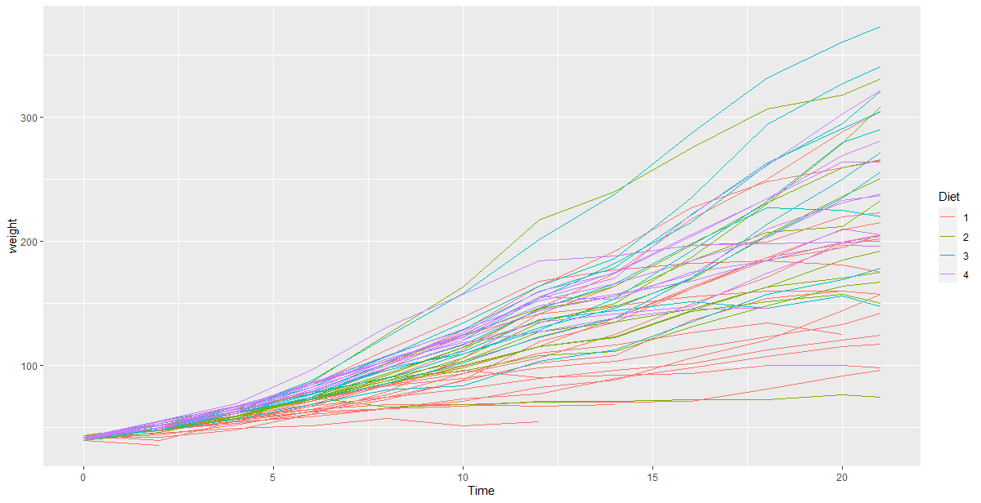
Answers 1)

Slide 63
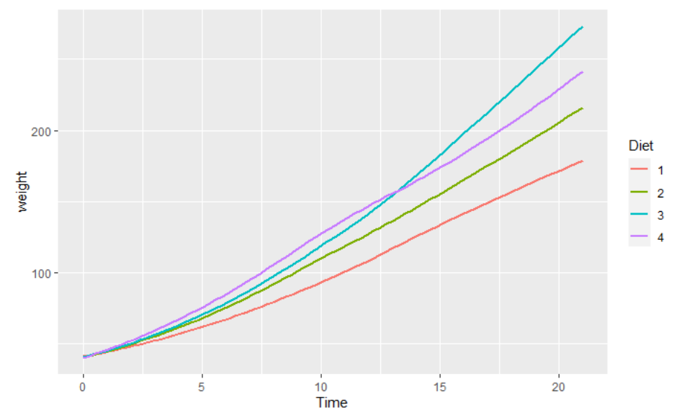
Answers 2)
We don’t need to specify grouping since geom_smooth() is designed to take all data and average it out

Slide 64
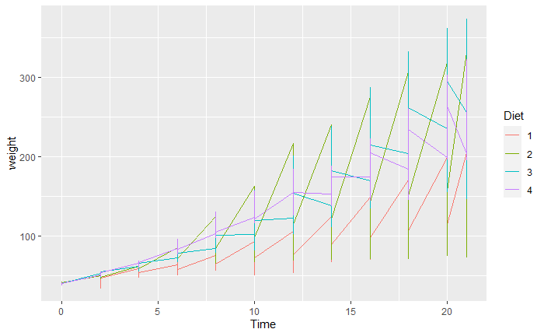
Group
Here the data from all chicks on the same diet is collected into a single line
at each unit of time where we measured weight, we get a vertical line, representing measurements for each of the diets

Slide 65
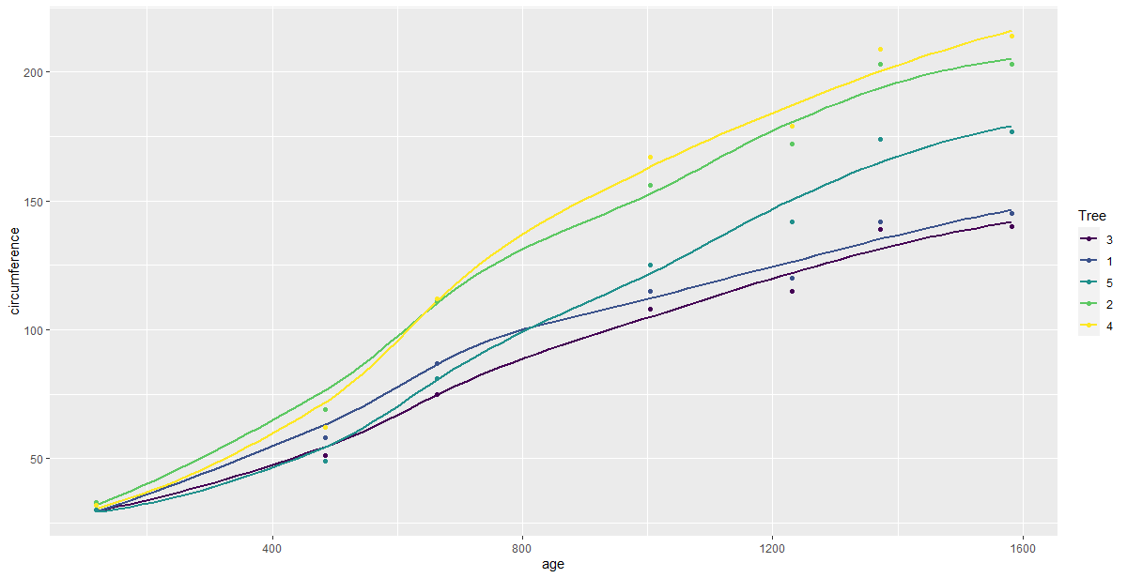
Global Aesthetics
If we use 2 geom layers, mapping our aesthetics every time is long winded
We can instead map our aesthetics in the ggplot() layer in aes()
These will be treated as global mappings instead of local mappings now
Note you can overwrite these in the local geom layers still

Slide 66
Bonus Questions

Slide 67
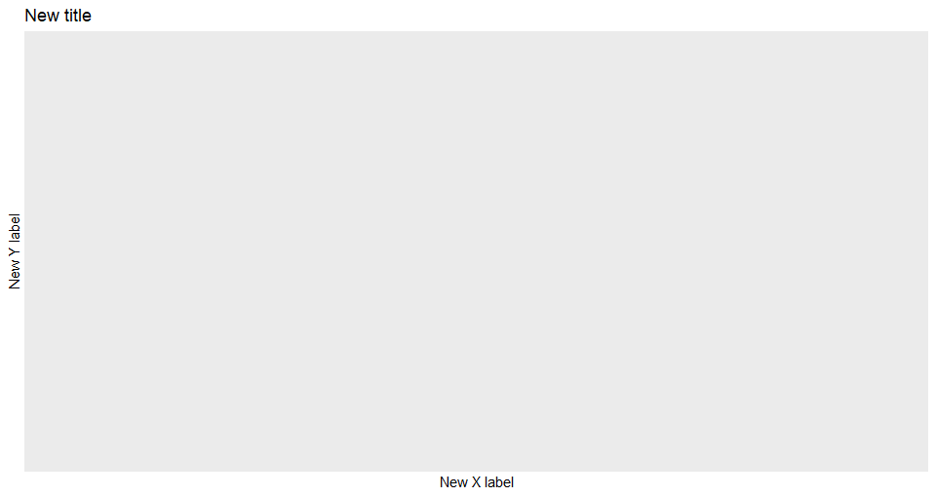
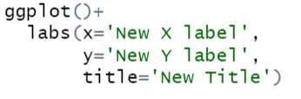
Labelling
We can change our x and y axis names in ggplot and add a title to our graph using a new layer labs()
It’s a simple case of adding more layers to our code as shown bellow:

Slide 68
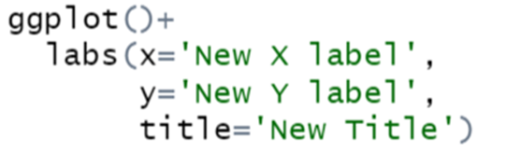
Exercises to try
Add a new title and x and y axis names to our previous plot ↓
ggplot(data = ChickWeight) +
geom_smooth(mapping = aes(x=Time, y=weight, colour =Diet), se=FALSE)

Slide 69

Answers 1)

Slide 70
Calculations

Slide 71
R as a calculator
We can also use things like trigonometry, square roots and logs in r
Normal format
R format
log(a,b)

Slide 72
Next Time ….
Stats
Comparisons
Boolean Operators
See you then !

Slide 73
R choosing the data types

Slide 74
R gets it wrong sometimes !
R will predict what data types you have in your columns but R sometimes gets this wrong:
Integers can be read as doubles
Characters can be read as things called strings
In this case we need to reimport our dataset and tell R what data types are in our columns
Notes:
a few more radar functions we have read underscore csv 2 that is for semicolon separated files so files similar to csvs but rather than co sorry rather than commas for separating values we use semicolons
there's read underscore tsv which is for reading tab separated files rather than a comma user tab and
read underscore delim which is for any form of delimited file so um it could be tab separated semicolon or column separated you just have to manually specify what character is being used to split out those different values
all of these accept the same arguments that we used for readers or csv so all names skip comment

Slide 75

Specifying the column data types:
You can manually specify column types using the col_types parameter with the cols()function
Any columns not specified will be guessed
Valid column types are logical, integer, double, character, factor, date, time, datetime, number (this is only used in special cases)
Notes:
a few more radar functions we have read underscore csv 2 that is for semicolon separated files so files similar to csvs but rather than co sorry rather than commas for separating values we use semicolons
there's read underscore tsv which is for reading tab separated files rather than a comma user tab and
read underscore delim which is for any form of delimited file so um it could be tab separated semicolon or column separated you just have to manually specify what character is being used to split out those different values
all of these accept the same arguments that we used for readers or csv so all names skip comment

